Slide 1
Welcome to Psy 652 Lab! Module 11: Analysis of Variance (ANOVA)

Slide 2

Objectives
Understanding ANOVA
Review planned contrasts in R
Code

Slide 3
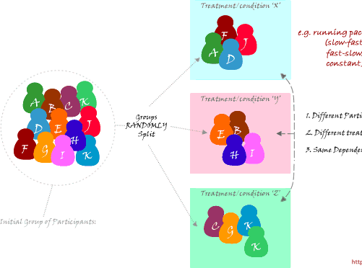
One-way ANOVA
A One-way ANOVA (What we will be using today) is used to determine whether there are any statistically significant differences between three or more independent groups.
Essentially, we are comparing the means between groups and seeing if they are statistically different from each other in an outcome variable.

Slide 4
What are planned contrasts and why are they useful?
Examine pairwise differences between groups
Pre-planned analyses reduce the need to correct for multiple comparisons
Conduct planned contrast tests after running the initial ANOVA

